Slide 1

INDIABANA project presentation

Slide 2
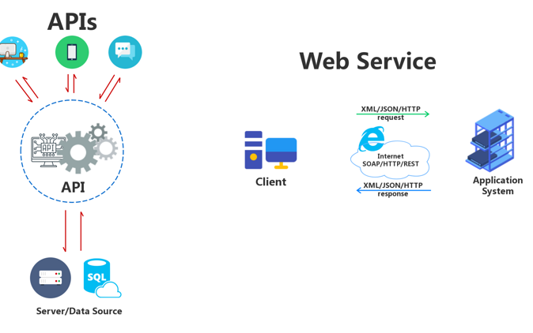
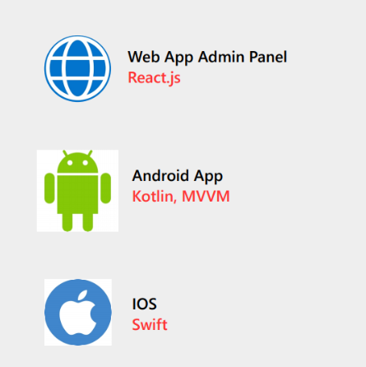
Selection of technologies
The scope of project will cover creation of a fully functional multi-vendor eCommerce Native Android mobile application and a Native iPhone mobile application along with Admin back end panel where anyone can create account and list products and anyone can buy.
I can deliver Customer App (Android, iPhone), Seller App (android, iPhone), Driver app (android, iPhone) Admin Panel (Web based).
AWS will be hired, initially the most basic plan or the free tier (recommend services to hire)
App Web (Stack MERN)
App mobile (Kotlin/Java)

Slide 3



VISION GENERAL
1
It is important that the information between the web and the app are synchronized since users will be able to access their account from the web and the app
DELIVERY
BUYERS
SELLERS
Sellers must send delivery request to delivery people (such as uber eats)
- Web
- App
- Web
- App
App

Slide 4
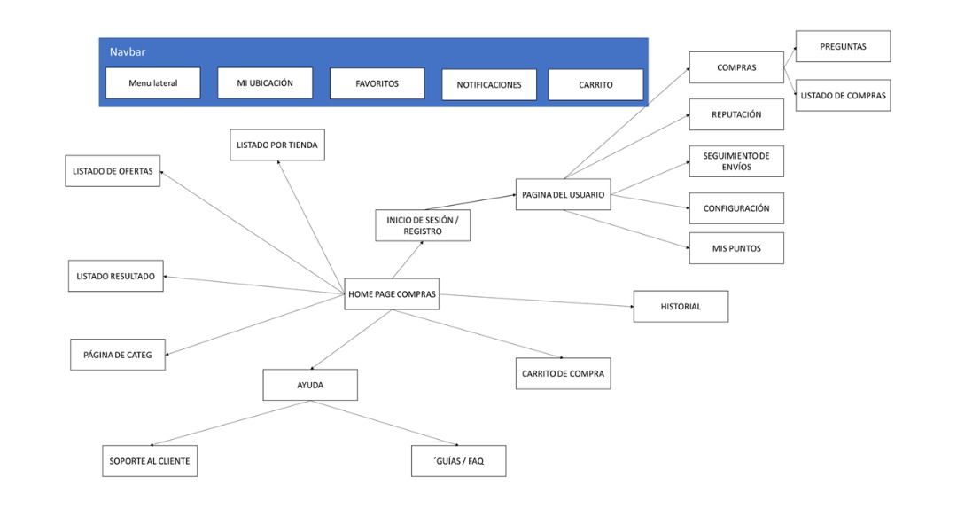

Slide 5
Integration with third party services
9
 | Payment gateway | Map and routes | Verification via SMS
Provider | Pago fácil | Google Maps | Twilio
Official supplier link | https://www.e-pagofacil.com/ | https://cloud.google.com/maps-platform/products | https://www.twilio.com/
Technical documentation | https://documentacion.pagofacil.net/ | https://developers.google.com/maps/documentation/javascript/overview?_ga=2.120012042.369474017.1608187852-872033197.1608187852&_gac=1.155298505.1608187943.CjwKCAiA_eb-BRB2EiwAGBnXXmGYVyB89ZScF9-CqasPks0osvzhmwGvAacH5HTmPd6609EDixvyQBoChhEQAvD_BwE | https://www.twilio.com/docs/api?filter-product=SMS

Slide 6
I recommend watching the following short videos to understand the flow of users
Purchase process and order tracking:
https://www.loom.com/share/360007b06c6c4e279c0f09e7e400b649
Buyer user panel:
https://www.loom.com/share/47436a87723f486ea1f608c59791e075
Quick tour of the vendor interface:
https://www.loom.com/share/85a996c6cc794fae87dda40ae01996c3

Slide 7
In the following slides I will show the functions that I consider to be the most complex

Slide 8
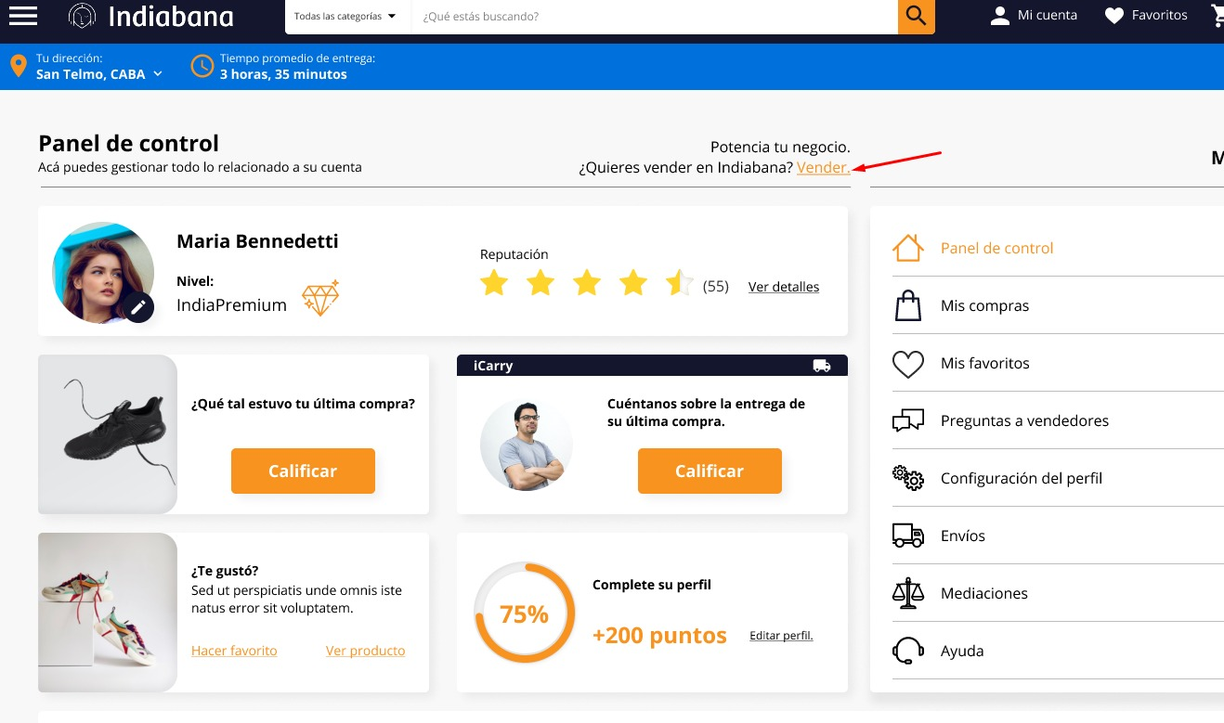
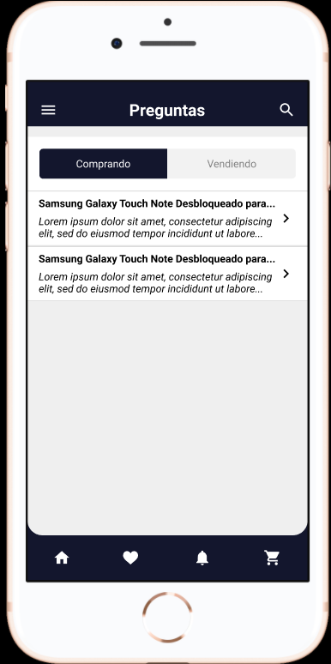
Ok, on the Indiabana platform, buyers can become sellers, see the picture
App Requirement
we are switching between seller/buyer in below screen but I am not clear about the seller user interface from the mockup after switching.

Slide 9
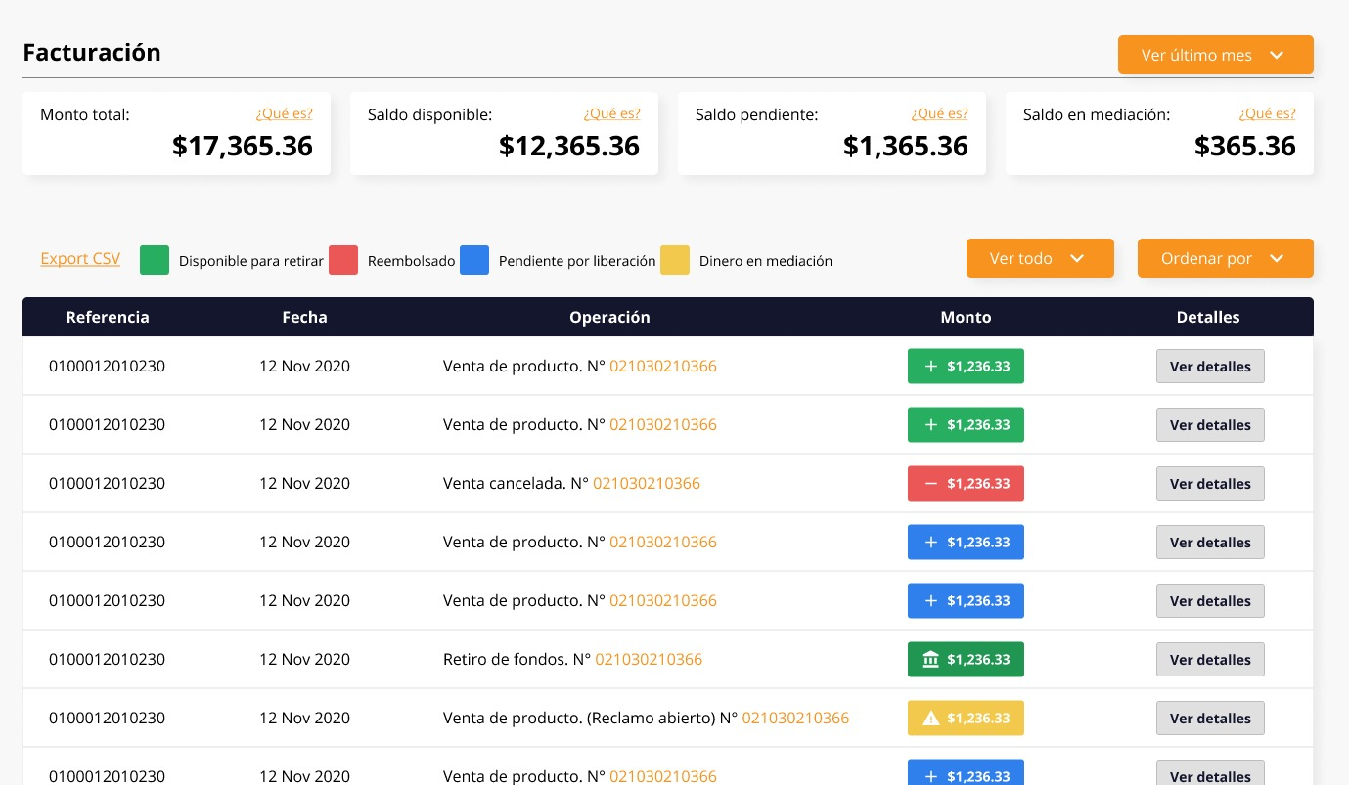
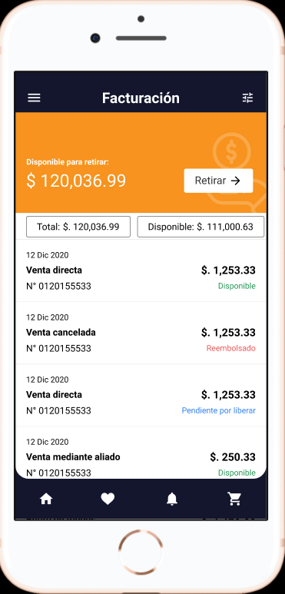
Here are the movements of the seller, that is, income and expenses, also the withdrawals of money to your account, how would you make it possible for the seller to request money from their income?
This is the expense screen in app. But I am not clear about does the same screen represents the transactions for both buyer and seller as the ui switch occurs. Also the current screen below is it the movement of seller or buyer??

Slide 10
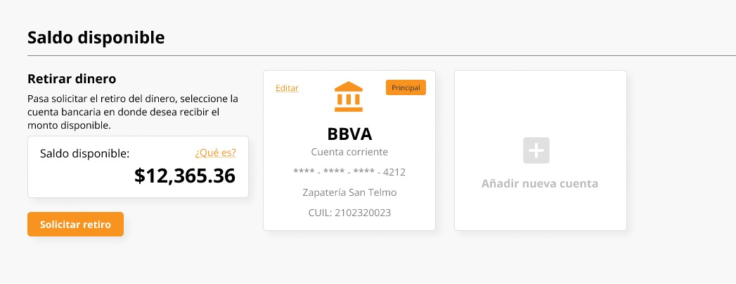
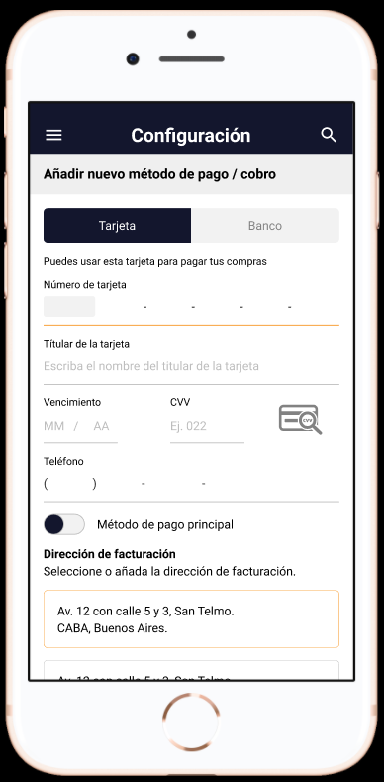
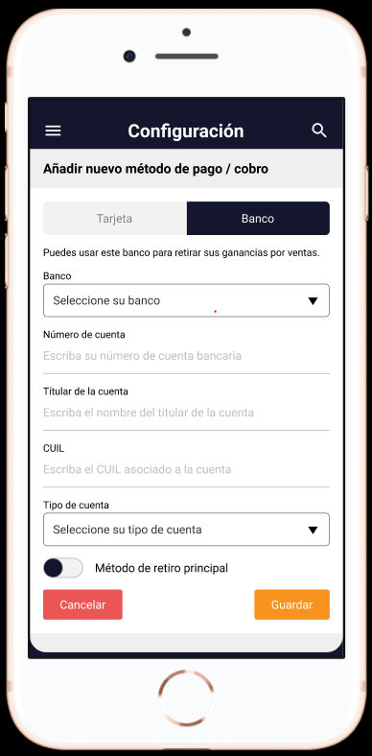
In theory, the user puts his bank details here where the administrator can send money to sellers
From the app-mockup I understand that here we are taking the bank details form the user but I need the language conversion doc for this which will make it completely clear for me.
Also please explain if the user interface would be same for both the buyer and seller for taking the input.

Slide 11
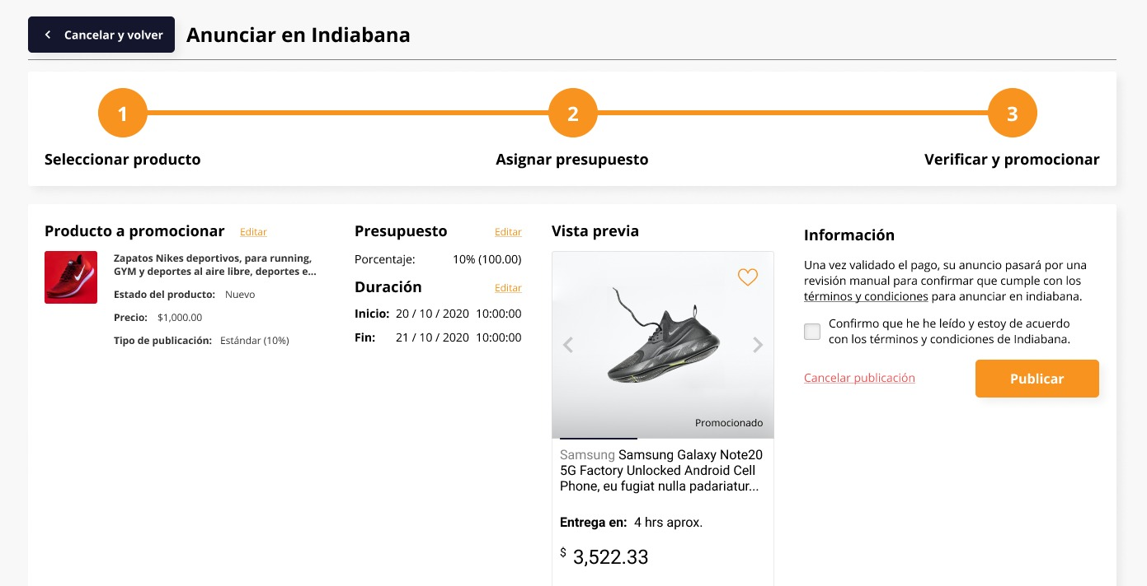
Here, in the ads section, sellers can promote their products so that they stand out in the first positions of the search results of users within the platform, this will be possible on the web, but it will be possible for the seller to request it from the App too?

Slide 12
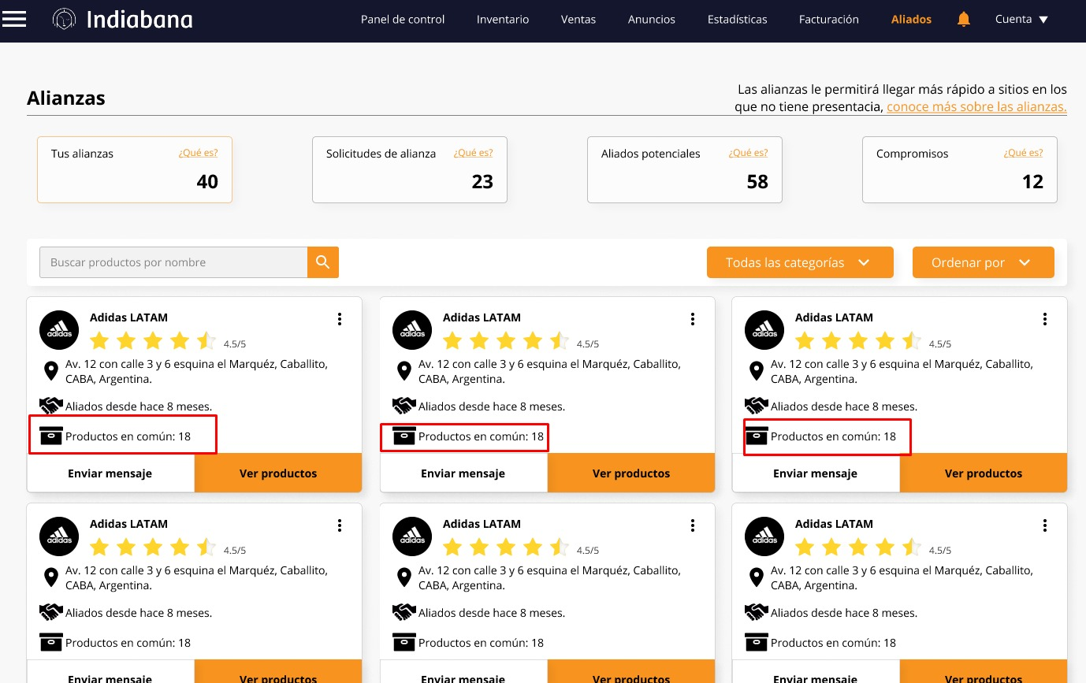
In this section, sellers can form alliances with other sellers to cover distances ... But before that happens, the seller will select the sellers who have the most products in common, how would you make that possible in the App?

Slide 13
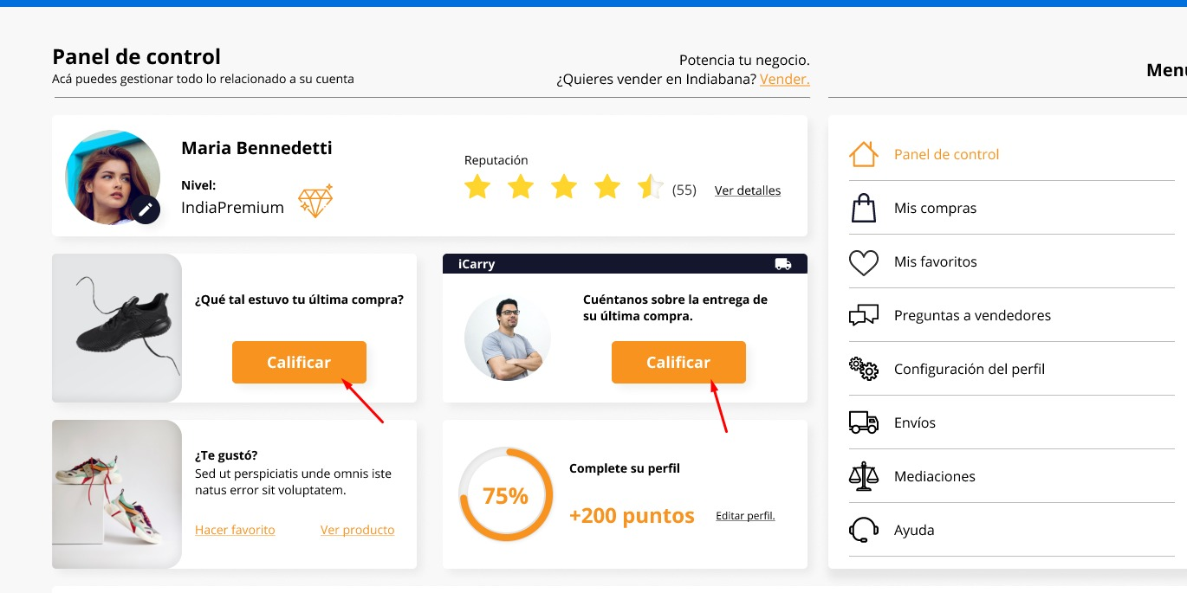
After the sale and delivery of the product is finished, the buyer can rate the seller and dealer from here

Slide 14
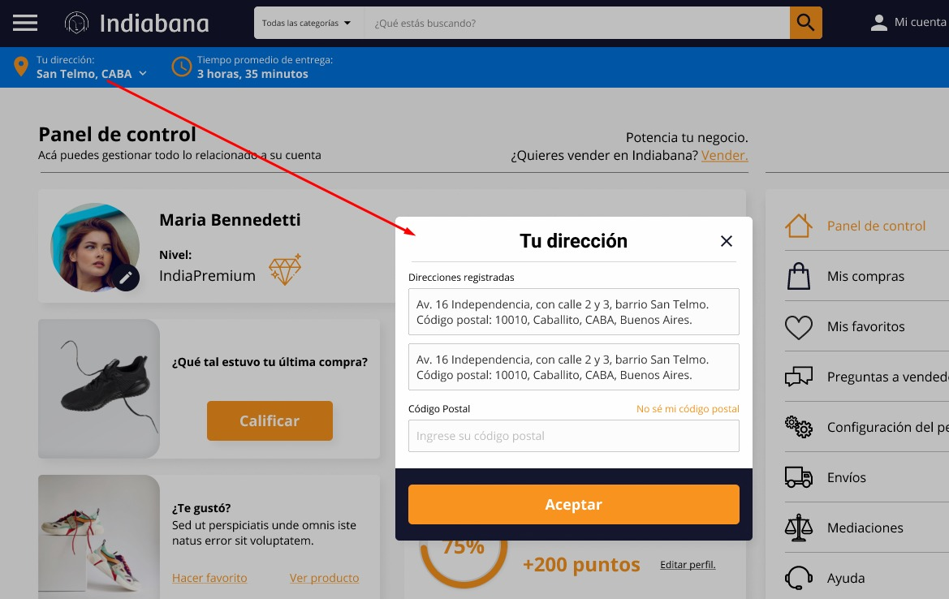
Here, the buyer must authorize the use of GPS to calculate the estimated delivery time

Slide 15
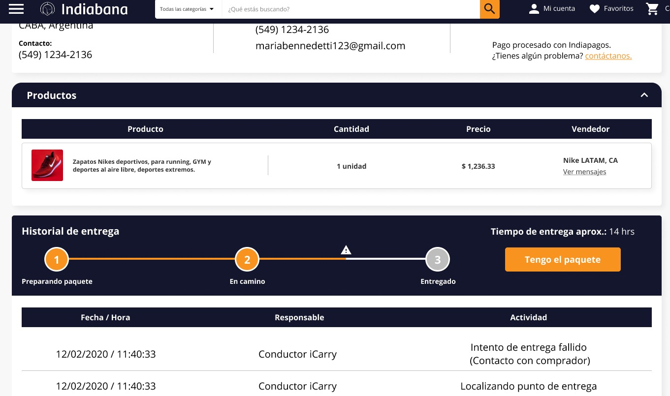
Here the buyer can see order status

Slide 16
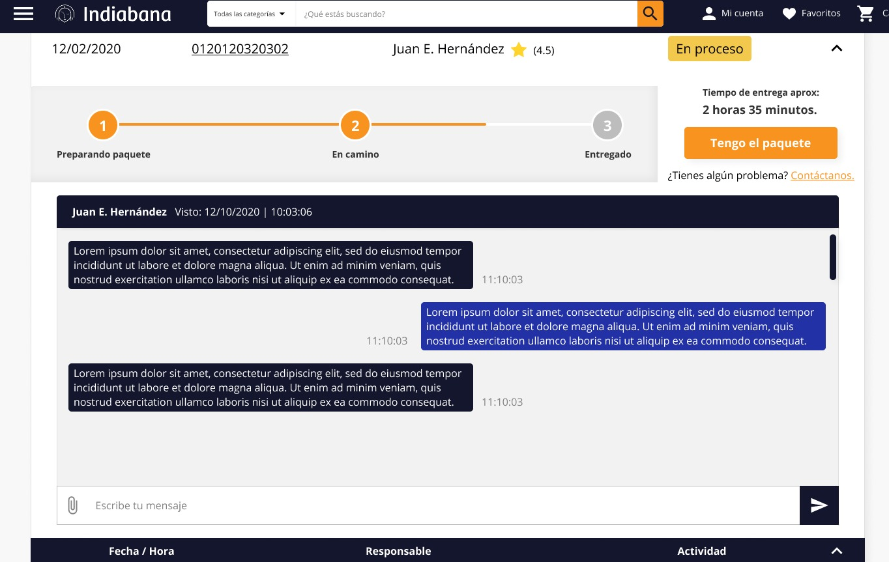
Here, they can chat between buyer and seller, how will this be possible in the App?

Slide 17
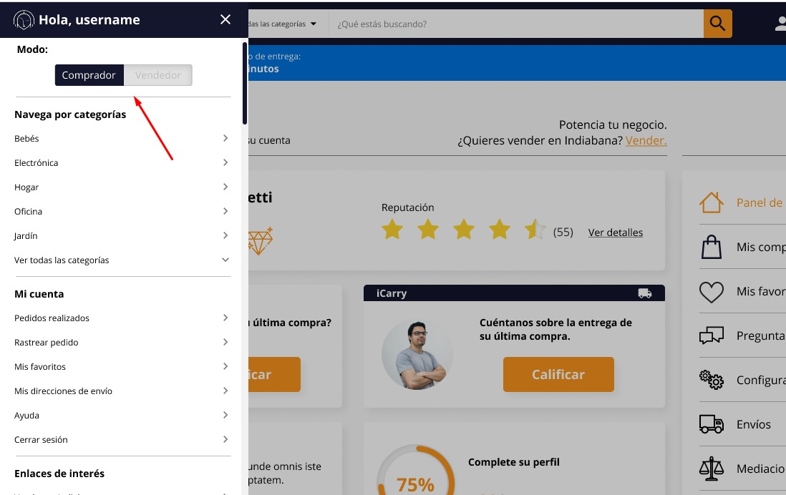
Here you can make a switch between buyer and seller profile

Slide 18
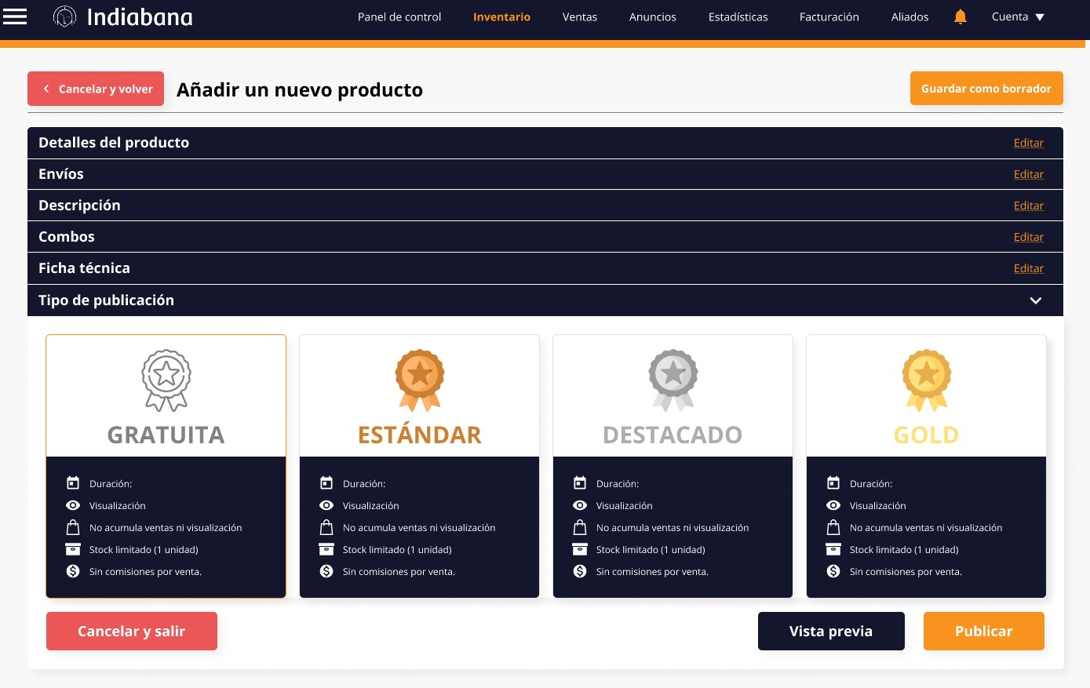
When the seller wants to publish a product, he can choose different plans (characteristics to be defined), for example the free plan could be active the publication of the product for a week, on the other hand if he chooses between one of the premium plans the publication of the product can be active for 1, 2, 3 months or indefinite depending on the plan.

Slide 19
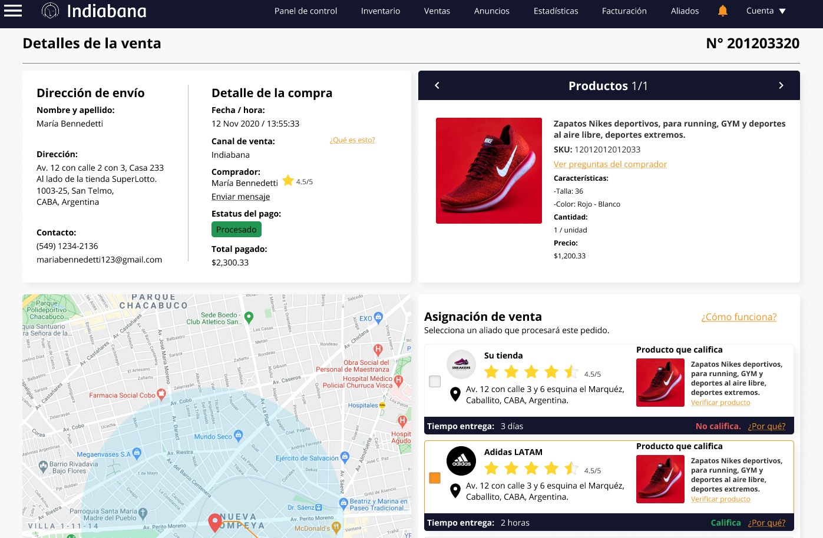
When the seller receives a sale and sees that the buyer is very far away, then he must choose between one of his allies, for this, he will see a list and on a map the locations closest to the buyer's address, then, the seller selects a the store that has stock of the product sold and is closest to the buyer, then sends a request to the delivery person.

Slide 20
FAQ
* Here you are the only sole seller or there are several sellers who can visit the website Can you create a store?
Answer: There will be multiple sellers and multiple buyers.
* If so, will there be multiple sellers, so will there be a membership or is it free?
Answer: Anyone can register as a seller or buyer for free.
* Here sellers will have a separate board where they can list all the products, manage the products, upload products by choosing category, subcategory, price, photo of the products, shipping costs?
Answer: Yes, correct.
* How will this shipment work? I mean the seller is taking a shipping service available from the admin or the seller will be responsible for their own shipping.
Answer: The seller will define the shipping costs from their seller panel
* How will the shipping fee be decided? Seller or will there be a distance based on? explain the logic of shipping costs
Answer: Mainly based on distance. Then I confirm.
* Are there coupons, offers, discounts? If so, who will create per admin for all stores or will the seller create for their online store?
Answer: The seller will create for their online store
* How will the payment be settled? I mean, when the user will pay, it will go directly to the seller or admin account and then the admin will pay the seller the deduction commission and the rest will be sent to the seller manually.
Answer: Not yet defined, but apparently it will go directly to the administrator's account and then the administrator will pay the seller ... Then I confirm.
* How will you manage the shipment of products? What kind of shipping method do you want to use? (such as free shipping, flat rate shipping)
Answer: Yes, there may be different shipping methods
* May I know what type of product you are selling on your site?
Answer: Any Physical Products
* What will all the products be? What categories and subcategories do you want?
Answer: Any type of product, such as Amazon. But so that the publication of a product for sale is easy for the seller, we are going to load the entire list of products as a catalog, in this way everything will be standardized and sellers will only select from that catalog the products to sell, if There is a product that is not in the list, then you will have the option to create your new product but it will go through a verification (administrator must approve)

